Slide 1
Research Overview

Slide 2

Professional Experience and Education
  Professor of Earth + Environmental Sciences, Columbia
    Previously Professor of Atmospheric + Oceanic Sciences, Wisconsin
  PhD, Climate Physics + Chemistry, MIT
Expertise
  Ocean carbon cycle, feedbacks with climate
  Ocean + climate modeling
  Data science
Synergistic Activities
  The Oceanography Society, Councilor, 2020-present
  JASON Advisory Group, 2015-present
  Diversity Committee chair, EES department, 2019-present
  Co-chair for undergrad education, Wisconsin AOS, 2010-15
2

Slide 3
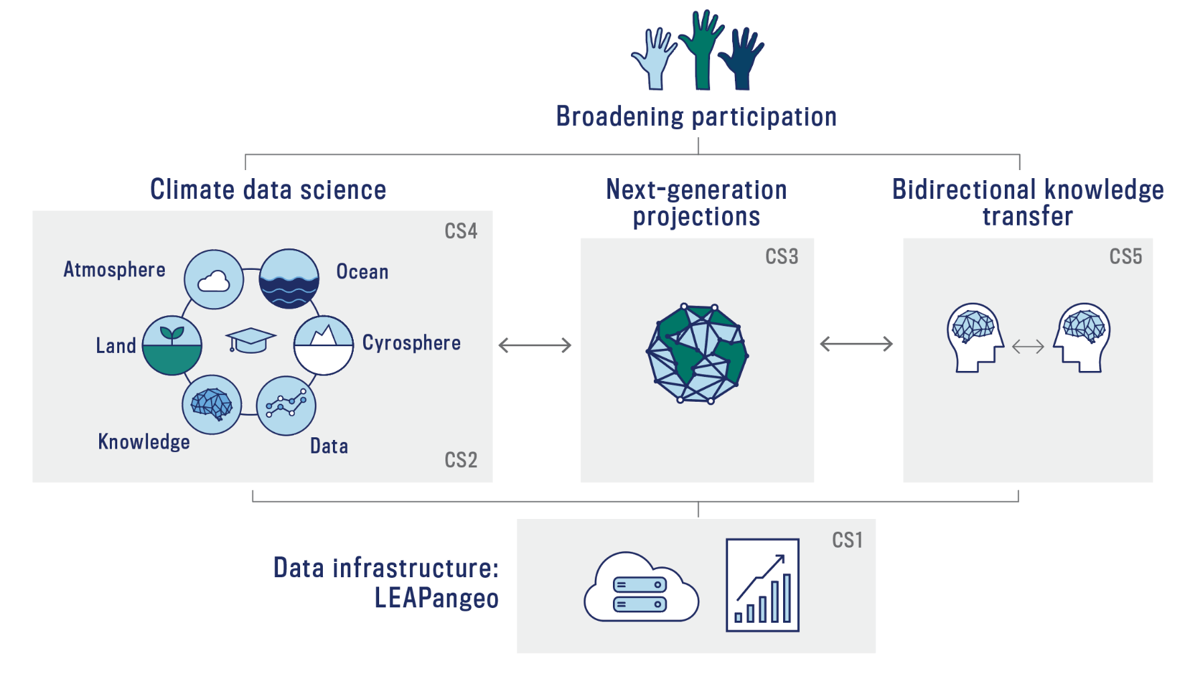
Structured research in climate data science is key to our vision
LEAP forward in the reliability, utility, and reach of climate projections through synergistic innovations in data science and climate science.
3

Slide 4
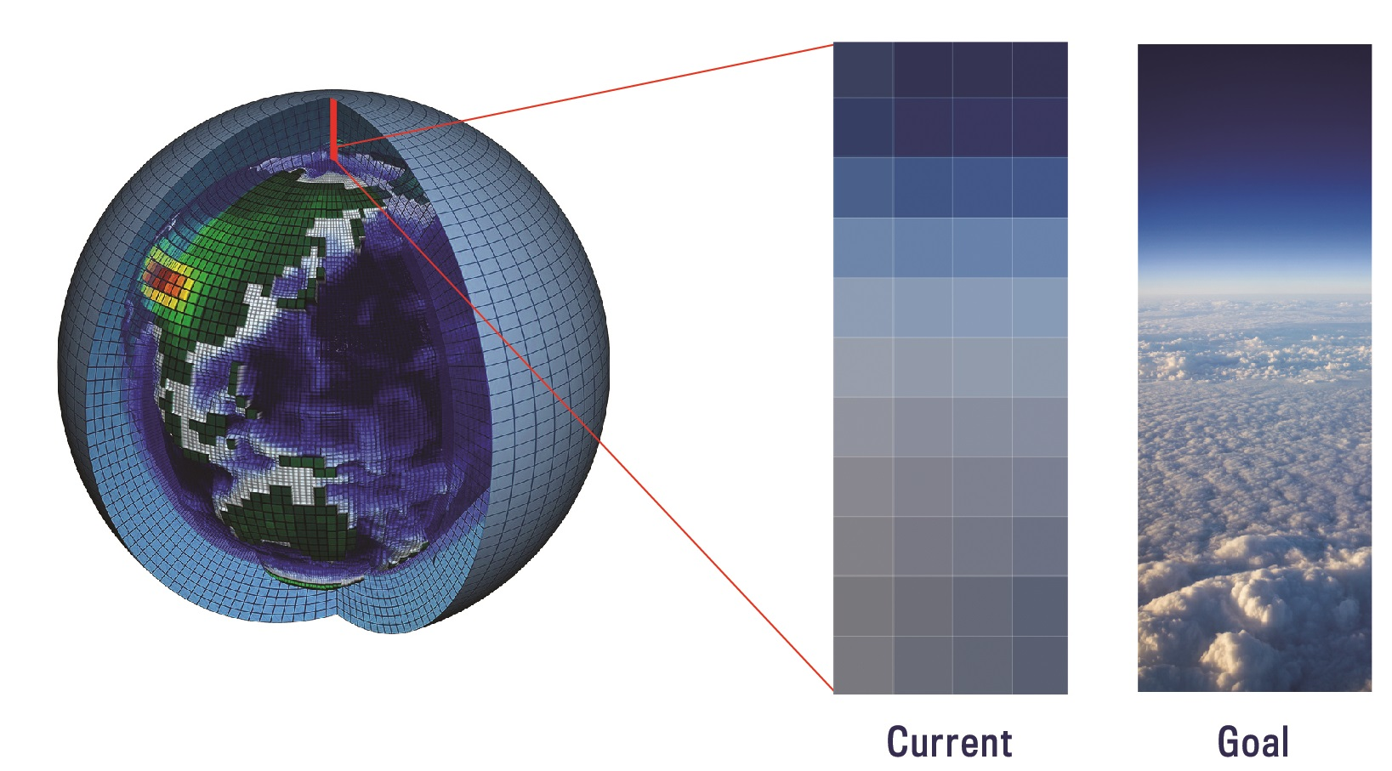
LEAP research objective #1:
Next-generation parametrizations built on data
4

Slide 5
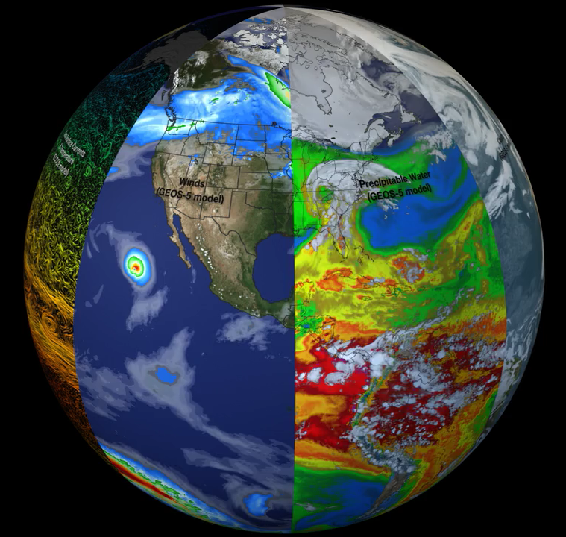
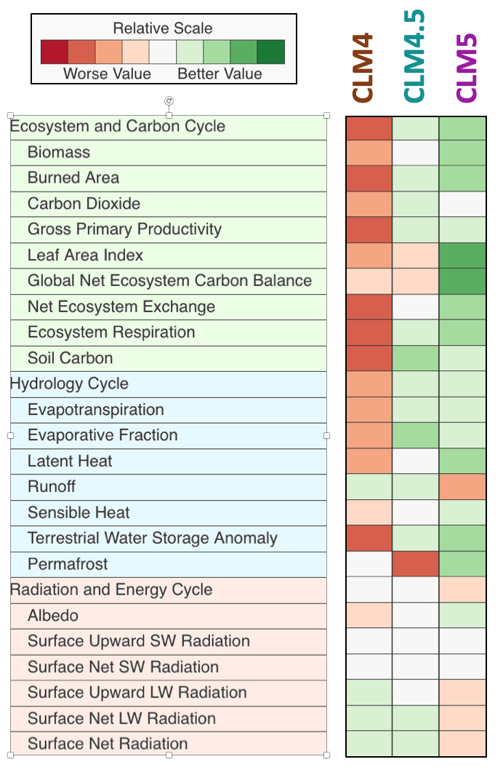
LEAP research objective #2:
Metrics: enhanced datasets and improved approaches to systematically evaluate ESMs against data
Model skill assessment
CESM’s land module
*
NASA
*CLM = Community Land Model
5

Slide 6

Data-driven parameterizations and metrics catalyze ESM development
Earth System Model
Data-driven parameterizations
Metrics: Datasets and approaches
Model refinements
Revised research priorities
6

Slide 7
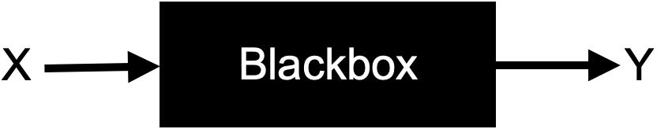
ML must be evolved to respect physics and be scientifically interpretable
Machine learning today
7

Slide 8
ML must be evolved to respect physics and be scientifically interpretable
Machine learning with LEAP
8

Slide 9
ML must be evolved to respect physics and be scientifically interpretable
Machine learning with LEAP
Why does X lead to Y?
How will future change in X, outside current distribution, impact Y?
What are the limits of ML for a particular problem?
9

Slide 10
Complex climate data provides a rich challenge for Machine Learning
Structured, linked, dynamic datasets
Progress in Machine Learning
10

Slide 11
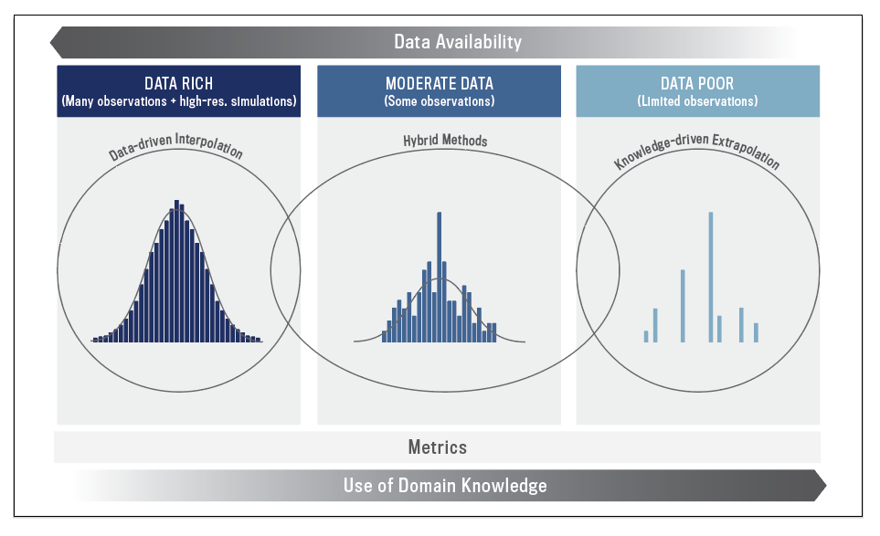
LEAP research is organized on a spectrum of data availability and process knowledge
11

Slide 12

For Data Rich, real or simulated data exist, but compute load disallows direct ESM application
12

Slide 13
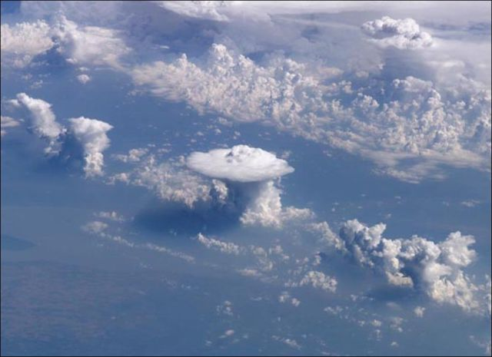
For Data Rich, real or simulated data exist, but compute load disallows direct ESM application
Example: Moist Convection
ESM Grid ~100km
13

Slide 14
For Moderate Data, data science can reveal causal links and increase generalizability
14

Slide 15
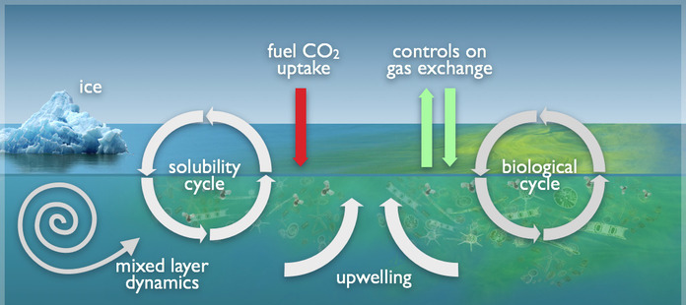
For Moderate Data, data science can reveal causal links and increase generalizability
Example: Ocean Biological Pump
15

Slide 16
For Data Poor, process knowledge will support parameterizations and uncertainty assessment
NOAA
16

Slide 17
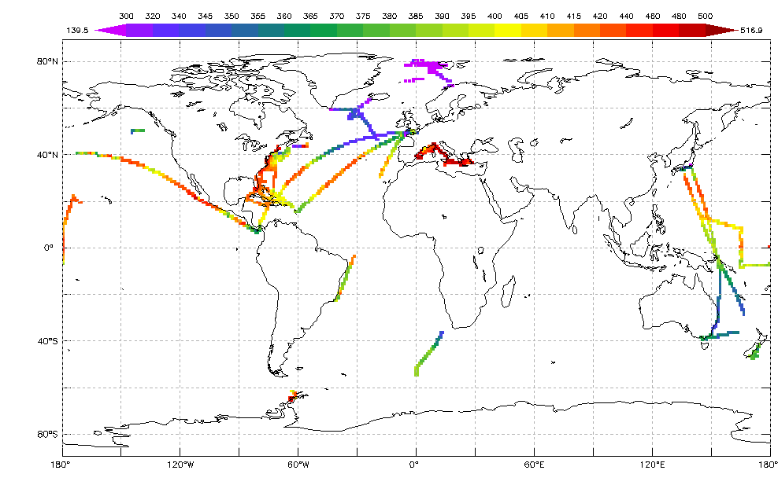
For Data Poor, process knowledge will support parameterizations and uncertainty assessment
Example: Air-sea carbon flux
NOAA
pCO₂ June 2016
17

Slide 18
LEAP research is organized on a spectrum of data availability and process knowledge
18

Slide 19
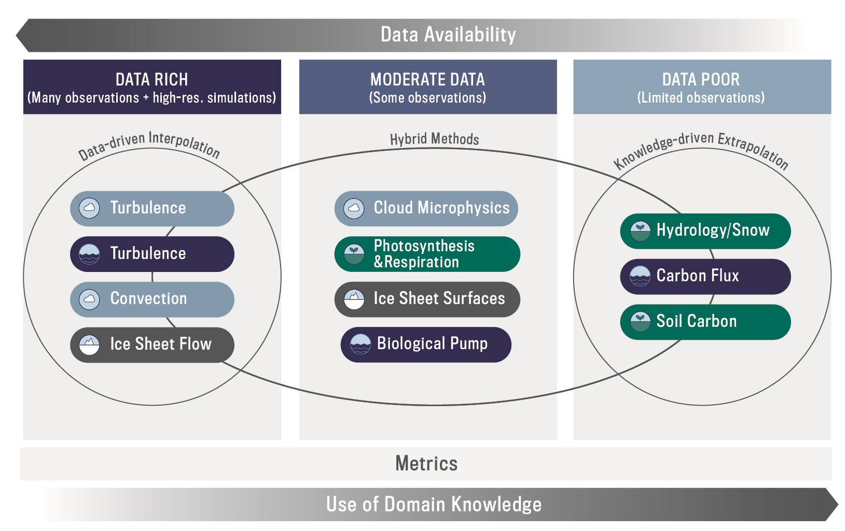
LEAP research is organized on a spectrum of data availability and process knowledge
19

Slide 20
Creating a community in climate data science is essential
20

Slide 21
Creating a community in climate data science is essential
Education programs from K-12 to postdoctoral
Research Working Groups
Annual Meetings
Comprehensive commitment to diversity, equity and inclusion (DEI)
21

Slide 22
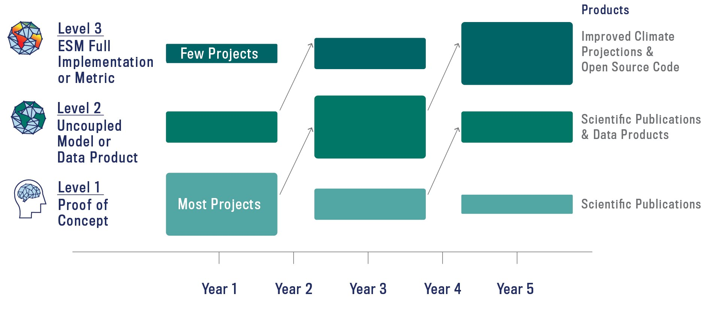
Research will be structured to progress from proof of concept to ESM implementation
22

Slide 23
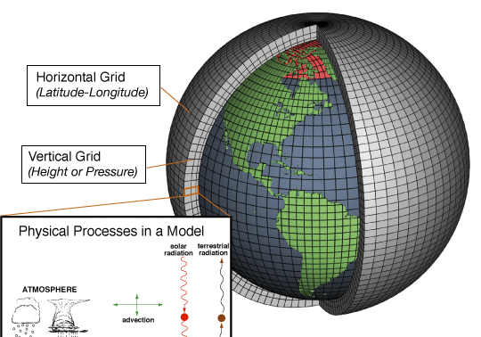
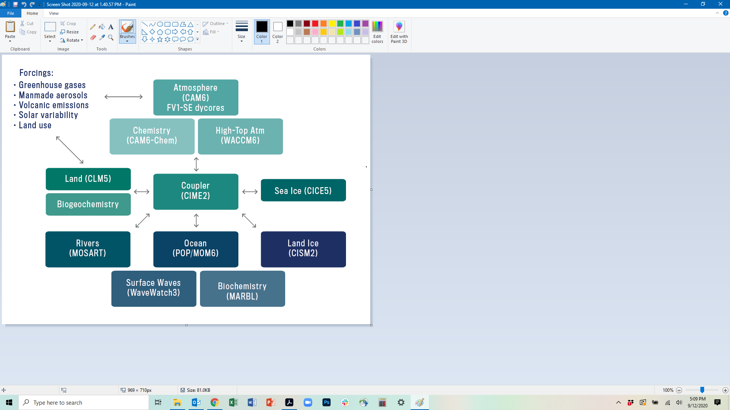
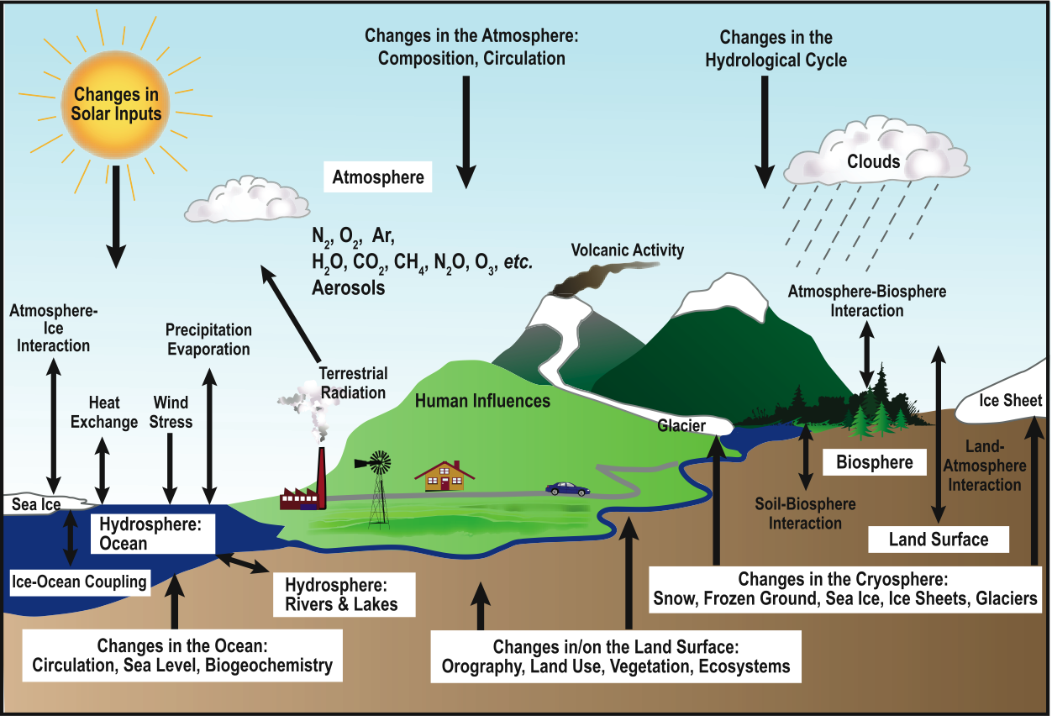
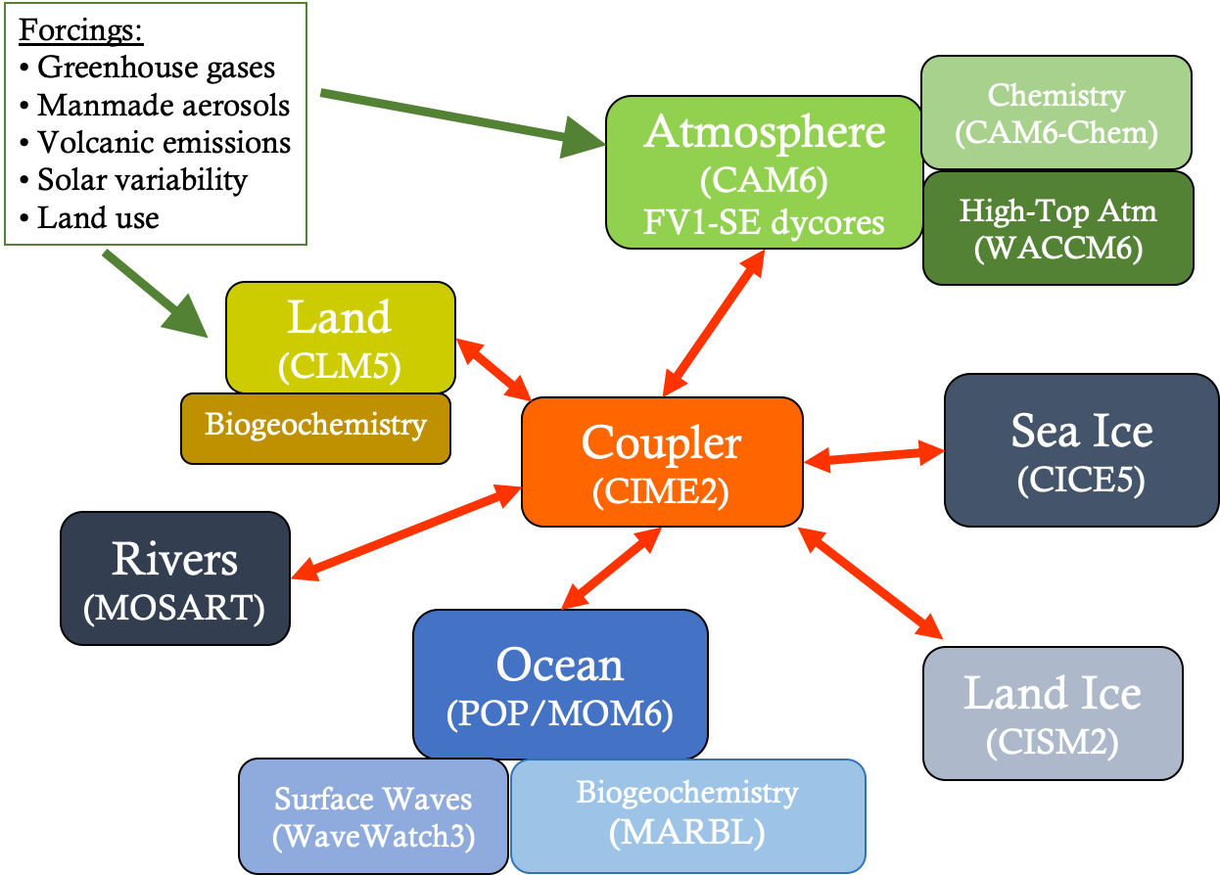
Potential research bottleneck: Coupling
23

Slide 24
Data-driven parameterizations and metrics catalyze ESM development
Earth System Model
Data-driven parameterizations
Metrics: Datasets and approaches
Model refinements
Revised research priorities
24

Slide 25
Structured research in climate data science is key to our vision
LEAP forward in the reliability, utility, and reach of climate projections through synergistic innovations in data science and climate science.
25

Slide 26
Questions and Feedback?

